Slide 1


TELECOM CHURN ANALYSIS
PROJECT
Nguyen Trong Duc

Slide 2
OVERVIEW
01 - Data Overview
02 - EDA
03 - Data Preprocessing
04 - Building Model

Slide 3





1- DATA OVERVIEW

Slide 4
1- DATA DISCOVERY
This is a dataset containing customer information of a telecom business. This data has 3333 rows and 20 columns, includes:
State: State where the customer lives
Account lenght: The length of time a customer uses a business's services
Area code: Area code
International plan: Indicates whether the customer is subscribed to an international calling plan (Yes or No)
Voice mail plan: Indicates whether the customer is subscribed to a voice mail service plan (Yes or No)
Number vmail messages: The number of voicemail messages the customer has received
Total day minutes: Total number of calling minutes during daytime hours
Total day calls: Total number of calls made during the daytime
Total day charge: Total charges for calls during daytime hours
Total eve minutes: Total number of calling minutes during the evening hours
Total eve calls: Total number of calls made during the evening
Total eve charge: Total charges for calls during evening hours
Total night minutes: Total number of calling minutes during night time
Total night calls: Total number of calls made during night time
Total night charge: Total charges for calls during night time
Total intl minutes: Total international calling minutes
Total intl calls: Total number of international calls
Total intl charge: Total charges for international calls
Customer service calls: Total customer service calls
Churn: Indicates whether the customer churned (True is Yes, False is No)

Slide 5
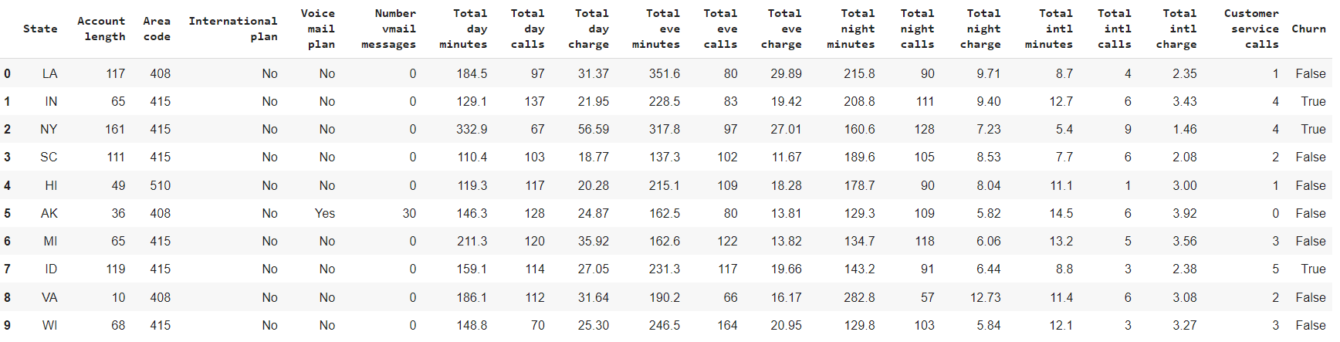
DATA SAMPLE

Slide 6

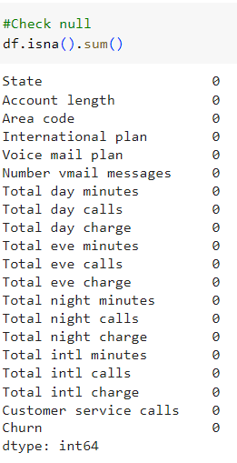
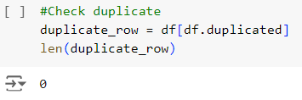
Check null
Check duplicate

Slide 7
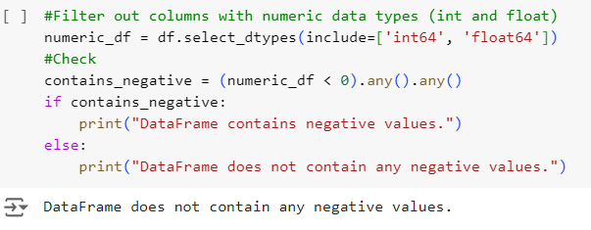
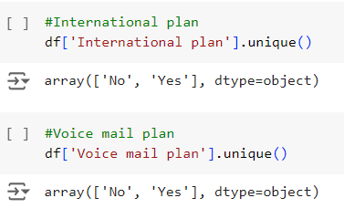
CHECK VALUES
Check if the dataset has negative values or not
Check values in categorical columns
➔ Conclusion: This dataset seems quite good. It has no null or duplicate values and these data types is correct. Besides, the values ​​in the columns are valid.

Slide 8
2- EDA

Slide 9
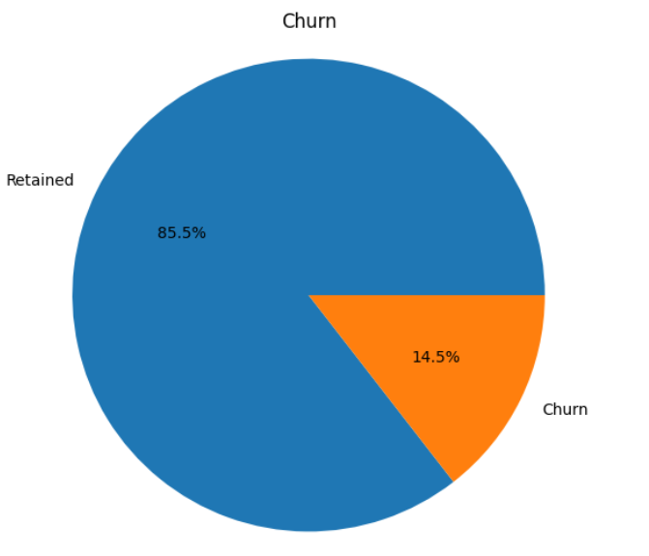
TARGET VARIANCE
There are 2850 users (85,5%) retained and 483 users (14,5%) churned. This data is highly imbalanced, it need to be processed before building the models.

Slide 10
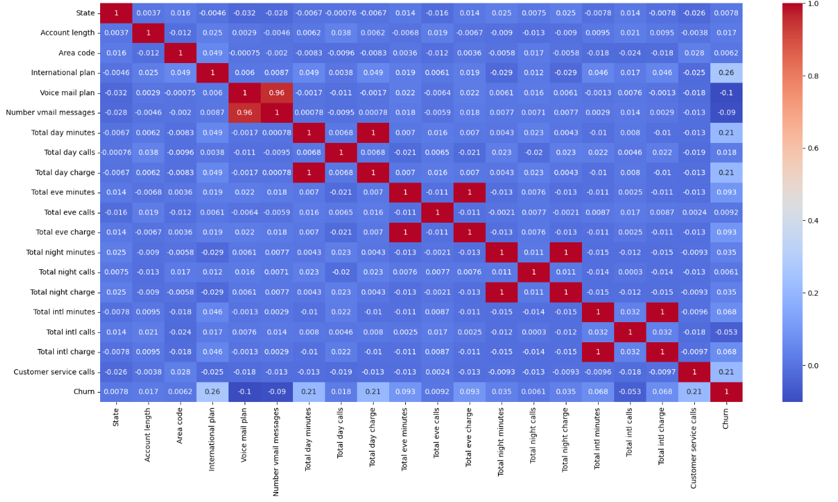
HEATMAP

Slide 11
INSIGHT
After drawing and observing Plot distribution of individual predictors by churn, combined with using Heatmap, I got some insights about this dataset.
1- Churn rates increase when the number of service calls increases
2- More customers churn when Total day minutes is greater than 300 and Total day charge is greater than 50
3- Churn rates increase when the customers subcribed the International plan

Slide 12
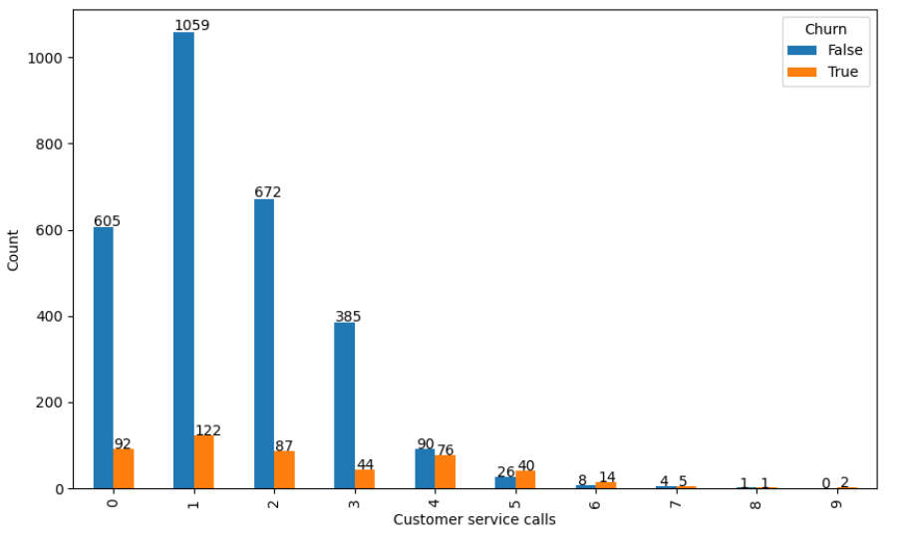
Churn rates increase when the number of service calls increases
Through the chart, we can see that the number of customers churned is always lower. However, with a total number of calls of 4, the number of customers churned and retained is almost equal. And from the 5th call, the number of customer churned is always higher.

Slide 13
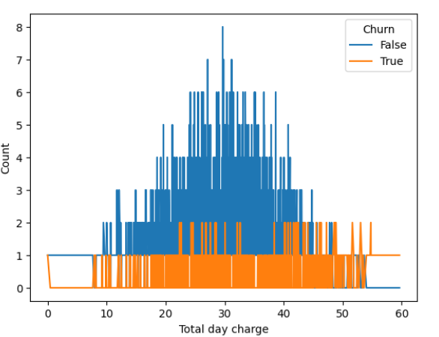
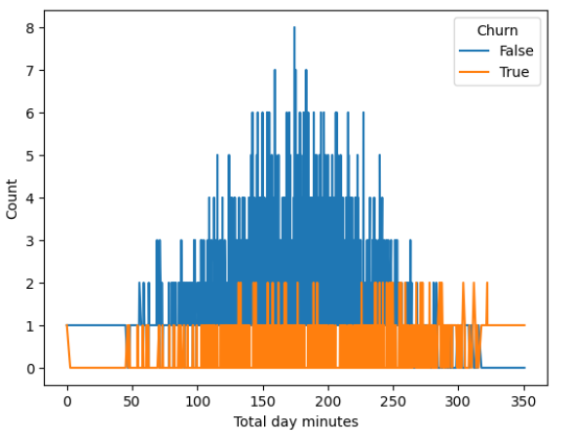
More customers churn when Total day minutes is greater than 300 and Total day charge is greater than 50
Through the chart, we see that the number of customers retained is always higher, but when the Total day minutes is greater than 300, the number of customers churned is higher. The same thing happens when Total day charge is greater than 50. This is understandable because these two factors are closely related; the more you call, the higher the cost.

Slide 14
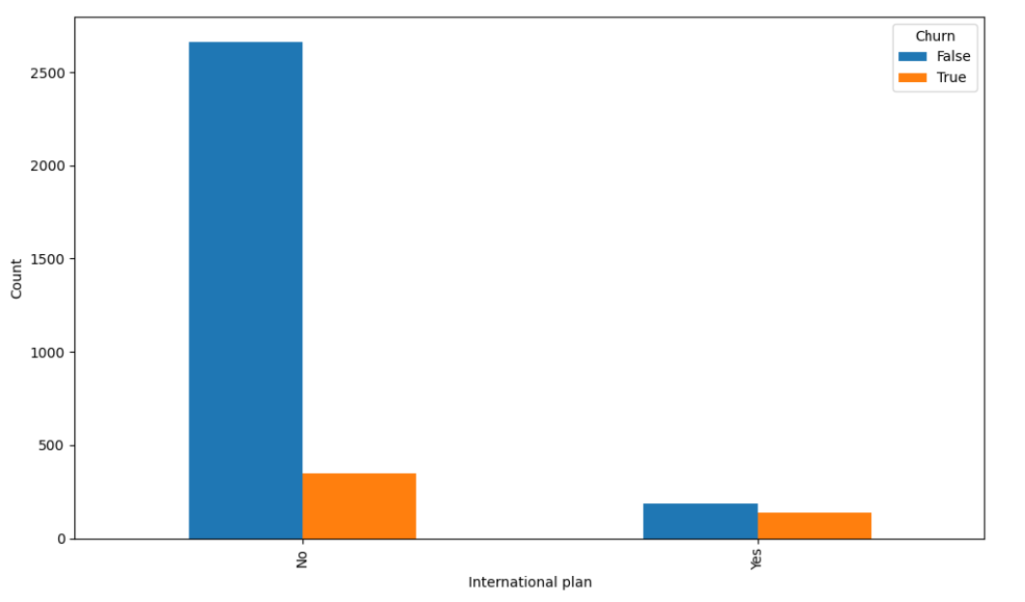
Churn rates increase when the customers subcribed the International plan
For the group of customers who didn't subcribe for the International plan, the number of retained customers was significantly higher. However, for subcribed groups, the number of retained customers and churned customers was almost equal.

Slide 15
3- Data Preprocessing

Slide 16
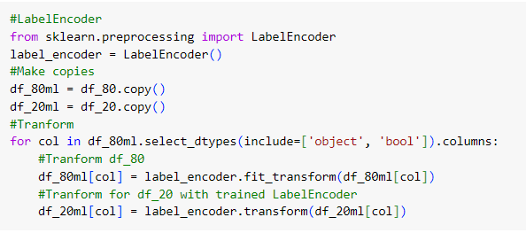
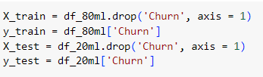
ENCODE
SPLIT DATA

Slide 17
4- BUILDING MODELS

Slide 18
EVALUATION METHODS
Since this is an imbalanced dataset, in addition to the Classification Accuracy, I will use the Confusion Matrix to evaluate models. I also use SMOTEENN to increase model performance.
I will give more importance to good prediction models for class 1, because it represents the class of customers likely to leave, which businesses are always concerned about first.
I builded and evaluated 4 models:
Decision Tree
Random Forest
K-Nearest Neighbor
Support Vector Machine

Slide 19
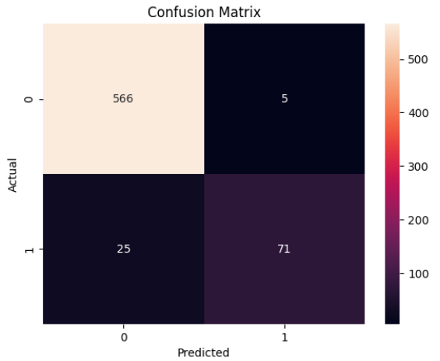
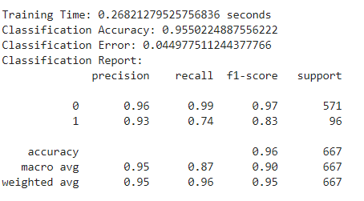
Model evaluation
Random Forest
The best model is Random Forest with the highet Classification Accuracy and best prediction for class 1

Slide 20
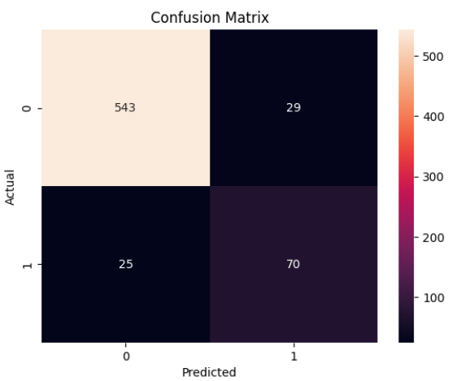
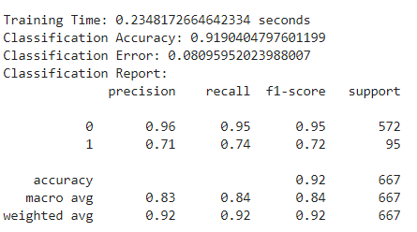
Model evaluation
Decision Tree
Decision Tree is also a good model with the shortest training time

Slide 21


Thank's For Watching

